Slide 1
CPI Inflation Case Study: An Analytical Deep Dive into India's Price Trends
Soumya Chander Upadhyay
29th July, 2025

Slide 2
Understanding India's Economic Pulse: The Role of CPI
Defining CPI and its Criticality in Economic Analysis
What is CPI?
Consumer Price Index (CPI) measures the average change over time in the prices paid by urban consumers for a market basket of consumer goods and services.
It serves as a key indicator of inflation, reflecting changes in purchasing power and the cost of living.
CPI in India
Problem Statement
India's diverse economy makes CPI a crucial metric for understanding economic stability and guiding policy decisions.
Fluctuations in CPI directly impact household budgets, business planning, and national economic growth.
To analyze historical CPI data for India (Rural, Urban, and Combined) from 2013 to 2023 to identify key inflationary drivers, assess trend dynamics, and understand the impact of major economic events.
CPI analysis provides crucial insights into economic health, guiding strategic decisions for stability and growth.

Slide 3
Decoding Inflation: Our Analytical Journey and Key Discoveries
A Snapshot of Approach, Core Findings, and Strategic Recommendations
The inherent volatility and complexity of inflation in India necessitated a data-driven approach to understand its underlying causes and trends.
Understanding the drivers of CPI is vital for effective economic management.
Problem
Approach the Problem
Utilized MS Excel for comprehensive data cleaning, transformation, and structuring of raw CPI data.
Employed advanced Excel functionalities, including Pivot Tables and various charting tools, to aggregate data, calculate growth rates, and visualize trends.
High-level findings
Food category consistently dominates CPI contribution, highlighting its significant influence on overall inflation.
Significant year-on-year fluctuations observed, with specific periods showing accelerated inflationary growth.
Varied month-on-month trends within food sub-categories, indicating seasonal and supply-chain specific volatilities.
COVID-19 had a distinct, differential impact on essential goods vs. non-essential services, revealing sector-specific vulnerabilities.
Strong correlation identified between fuel prices and related economic sectors, indicating a cascading effect on broader inflation.
Our analysis reveals multi-faceted inflation drivers, emphasizing the need for targeted interventions and proactive economic management.

Slide 4
The Foundation of Insight: Data Landscape and Analytical Toolkit
Data Source:
Consumer Price Index (CPI) data for India, sourced from publicly available economic datasets.
Primary dataset: CPI Inflation Case Study.xlsx
Key Data Files Used:
CPI_Inflation Raw.csv: Contains granular raw data including Sector, Year, Month, Original Classification, CPI Value, and the custom Classified_As categories.
CPI_Inflation_Main.csv: Provides aggregated CPI values across various detailed categories for different sectors and time periods.
Insight 1-5.csv (and other insight-specific sheets): Pre-processed data tailored for deriving specific insights.
Data Time:
Historical data spanning from January 2013 to May 2023.
Data Caveats:
Analysis is based on aggregated national-level data (Rural, Urban, Rural+Urban), and does not delve into specific regional or state-level variations.
Calculations Performed:
Month-on-Month (MoM) growth rates.
Year-on-Year (YoY) growth rates.
Average CPI values for various categories.
Correlation coefficients between related CPI components.
Robust data preparation and Excel's analytical capabilities enabled a comprehensive exploration of India's CPI trends.

Slide 5
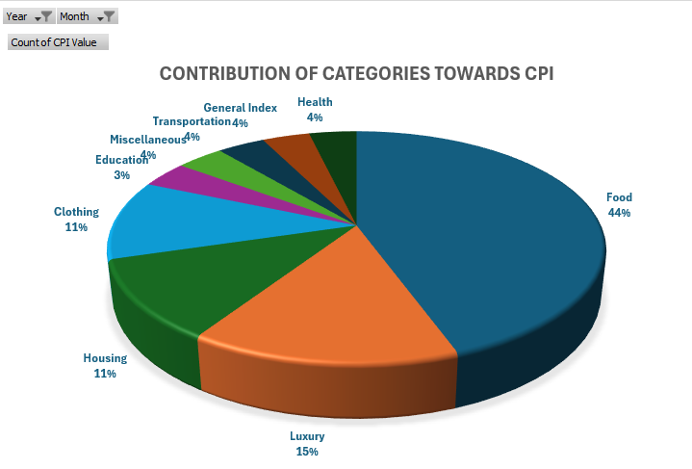
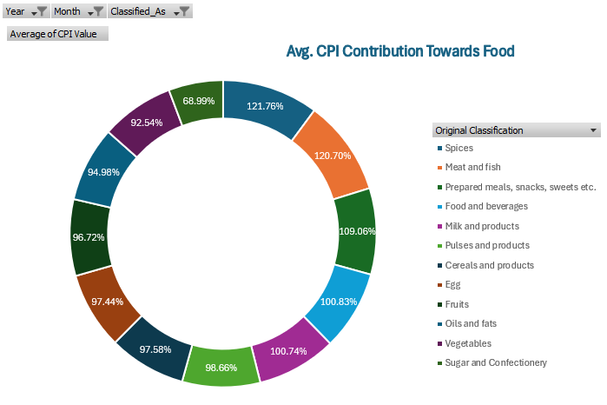
Unpacking the CPI Basket: Dominant Contributors to Inflation
Analyzing the Weight of Classified Categories and Food Sub-Components
Important Insights
"Food" consistently holds the largest share in the overall CPI calculation, underscoring its critical influence on India's inflation landscape.
Within the food basket, specific items like Spices and Meat & fish show significantly higher average CPI values, indicating their disproportionate impact on food inflation.
Key points to consider
Supply-side factors, seasonal variations, and demand-supply gaps are crucial considerations for effectively managing food inflation.
Overall Contribution
This pie chart illustrates the percentage share of each broader Classified_As category (e.g., Food, Luxury, Housing, Clothing, Education, Miscellaneous, Transportation, Health, General Index) to the total CPI for a specific period (e.g., May 2023, Rural+Urban data from Insight 1.csv).
Food Category Deep Dive
The donut chart provides a granular view of the average CPI values for sub-components within the "Food" category for the same period.
Food inflation, driven by specific commodities, remains the primary challenge in managing India's overall CPI.

Slide 6
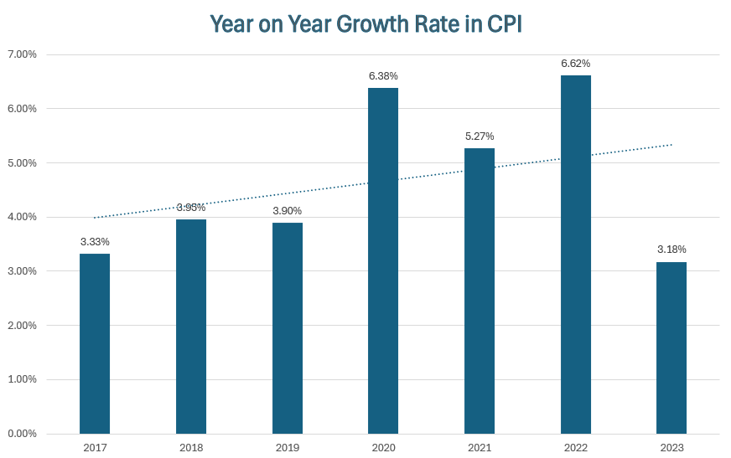
The Pace of Change: Annual Inflation Dynamics in India
Tracking the Year-on-Year Growth of the General Index
Important Insights
Identify periods of significant acceleration or deceleration in the overall inflation rate, such as the notable increase in 2020.
Highlight specific years where growth rates deviated significantly from the preceding trend, indicating underlying economic shifts.
Key points to consider
Macroeconomic policies, global economic conditions, and domestic factors (e.g., supply shocks, demand changes) play a crucial role in influencing the overall price level year-on-year.
This line chart displays the average CPI Value for the "General Index" (Rural + Urban combined) across the years from 2016 to 2023, sourced from Insight 2.csv.
Analyzing YoY growth reveals long-term inflationary pressures and provides insights into the effectiveness of past economic measures.

Slide 7
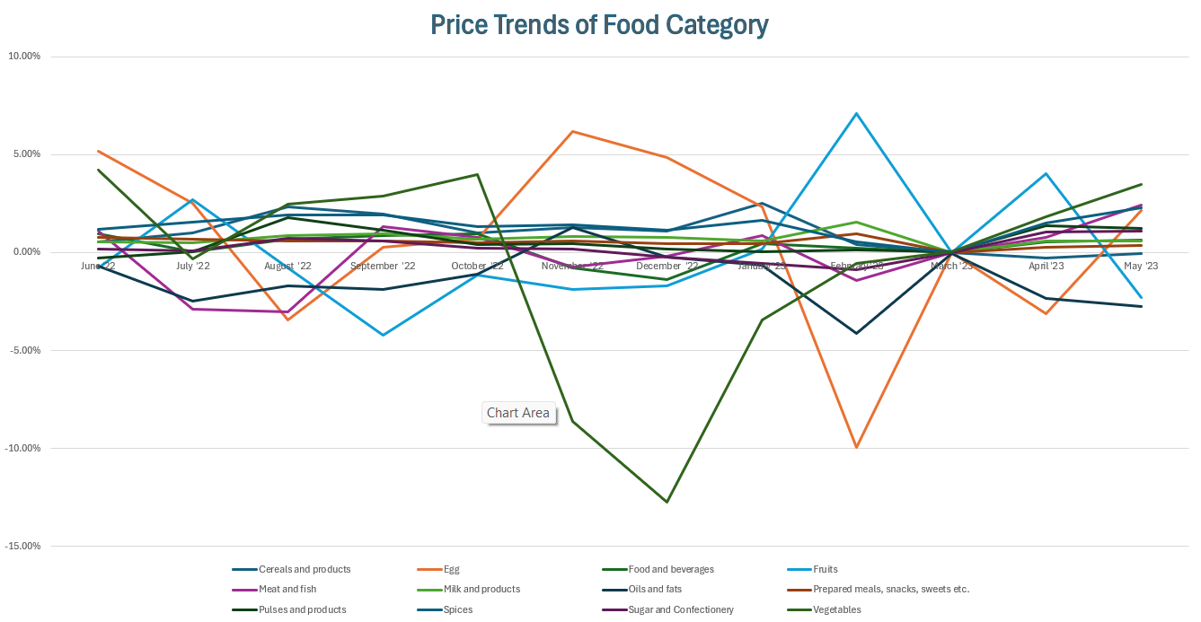
Granular Volatility: Monthly Price Shifts Within the Food Basket
Pinpointing Short-Term Fluctuations in Essential Food Items
Important Insights
Observe categories exhibiting high month-on-month volatility, such as Vegetables (e.g., 4.19% in June '22, 10.07% in July '22) and Fruits, often influenced by seasonal factors and immediate supply conditions.
Identify consistent upward or downward trends in particular food items, which may indicate persistent supply issues or market corrections.
Key points to consider
Macroeconomic policies, global economic conditions, and domestic factors (e.g., supply shocks, demand changes) play a crucial role in influencing the overall price level year-on-year.
The charts highlight the short-term price movements and volatility within these essential categories.

Slide 8
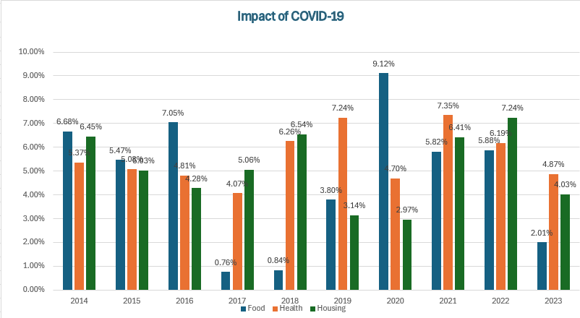
Pandemic's Economic Echo: Inflationary Shifts During COVID-19
Assessing the Differential Impact on Key Sectors
Important Insights
Observe the immediate and lingering effects of lockdowns:
Food: Often saw initial spikes due to supply chain disruptions and panic buying, followed by stabilization or further increases.
Health: Experienced sustained increases, reflecting heightened demand for medical services and supplies.
Housing: Showed more stable or delayed impacts, sometimes reflecting reduced demand or government interventions.
The pandemic exposed distinct vulnerabilities and resilience across different economic sectors.
Key points to consider
Supply chain resilience, shifts in consumer behavior (e.g., increased spending on essentials), and government relief measures played crucial roles in shaping inflation during the pandemic.
This line chart displays the Year-on-Year (YoY) growth rates for "Food," "Health," and "Housing" categories from 2014 to 2023, sourced from Insight 4.csv.
The pandemic exposed vulnerabilities and strengths in different economic sectors, influencing inflation dynamics in unique ways and highlighting the need for crisis preparedness.

Slide 9
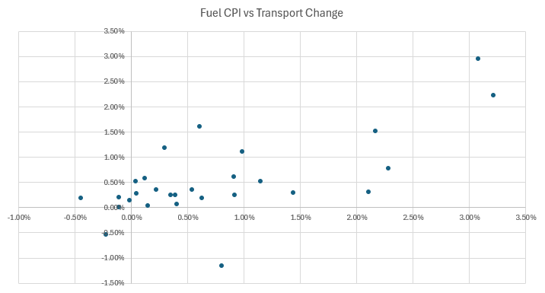
Global Ripples: How Oil Prices Fuel Domestic Inflation
Examining Correlations Between Fuel and Related Economic Indicators
Important Insights
A strong positive correlation (0.6718) between Fuel CPI and Transport CPI indicates that changes in fuel prices directly and significantly impact transportation costs.
Key points to consider
Global geopolitical events, crude oil supply and demand dynamics, and government taxation on fuel are critical external factors influencing domestic inflation.
This chart (e.g., Scatter Plot or Dual-Axis Line Chart) illustrates the relationship between "Fuel" CPI and other correlated categories such as "Transport”. The calculated correlation coefficients are explicitly stated (e.g., Fuel vs. Transport: 0.6718. The chart also shows Month-on-Month changes for Fuel and its correlated categories, demonstrating their synchronized movements.
Global oil price volatility significantly impacts India's inflation, particularly through transportation costs, necessitating strategic energy policies and supply chain optimization.

Slide 10
Strategic Pathways: Actionable Insights for Inflation Management
Policy and Operational Recommendations Based on Data-Driven Findings
Enhance Food Supply Chain Resilience
Diversify Energy Sources & Manage Fuel Taxes
Recommendation: Invest in improved cold storage facilities, efficient transportation networks, and reduce post-harvest losses.
Rationale: To mitigate price volatility of perishable food items (e.g., vegetables, fruits, spices) identified as major CPI contributors.
Recommendation: Accelerate transition to renewable energy and consider dynamic tax adjustments on fuel to cushion consumers from global oil price shocks.
Rationale: To reduce reliance on imported crude oil and its cascading inflationary effects on transport and other goods.
Leverage Data for Predictive Analytics
Recommendation: Move beyond descriptive analysis to implement advanced time-series forecasting models (e.g., ARIMA, Prophet) using additional economic indicators.
Rationale: To anticipate inflationary pressures more effectively and enable proactive policy responses.
Strengthen Health Sector Infrastructure
Monitor and Intervene in High-Growth Categories
Recommendation: Increase public health spending and ensure robust supply chains for medical goods and services.
Rationale: To prevent inflationary spikes in the health sector during future public health crises, as observed during COVID-19.
Recommendation: Establish early warning systems for categories consistently showing high year-on-year or month-on-month growth.
Rationale: To enable timely policy interventions (e.g., import/export adjustments, targeted subsidies) to stabilize prices.
Proactive and targeted policy interventions, coupled with continuous data monitoring and advanced analytics, are essential for effective inflation management in India.

Slide 11
Acknowledging Boundaries and Charting Future Explorations
Understanding Project Scope and Potential Avenues for Deeper Analysis
Limitations of Current Analysis:
Data Granularity: This analysis is primarily at a national and broad sectoral level; it does not cover specific regional or state-level CPI variations.
Causation vs. Correlation: While strong correlations were observed (e.g., Fuel and Transport), the analysis primarily identifies relationships and does not definitively establish direct causation without deeper econometric modeling.
External Factors: Other significant macroeconomic variables (e.g., specific government monetary and fiscal policies, global trade agreements, geopolitical tensions beyond oil) were not explicitly integrated into this study.
Tool-Specific: Reliance on Microsoft Excel, while powerful for this project, limits the complexity of statistical modeling and automated processes that could be achieved with specialized software.
Future Work & Next Steps:
Geographic Deep Dive: Conduct detailed CPI trend analysis at specific state or district levels to identify localized inflationary pressures.
Advanced Modeling: Employ statistical programming languages (e.g., Python with Pandas, Matplotlib, Seaborn, Scikit-learn; or R) for more complex time-series forecasting and econometric analysis.
Incorporate Policy Variables: Integrate specific government policy changes (e.g., interest rate adjustments, subsidy programs) into the analysis to study their direct impact on CPI.
Consumer Behavior Analysis: Incorporate consumer spending patterns and income data to understand demand-side inflation drivers more comprehensively.
While comprehensive, this analysis serves as a foundation, with significant opportunities for more granular, predictive, and holistic future studies.

Slide 12
Thank You / Q&A
Your Questions, Our Insights. Open for any questions or discussions.
Soumya Chander Upadhyay 29th July, 2025
LinkedIn: www.linkedin.com/in/soumyachanderupadhyay GitHub Repository: github.com/soumya-upadhyay/data-analytics-projects

